Slide 1
WIRELESS COMMUNICATION AND NRF MODULE

Slide 2
INsert pic of Joystick module and led dimmer

Slide 3



Simple example of Wireless communication

Slide 4
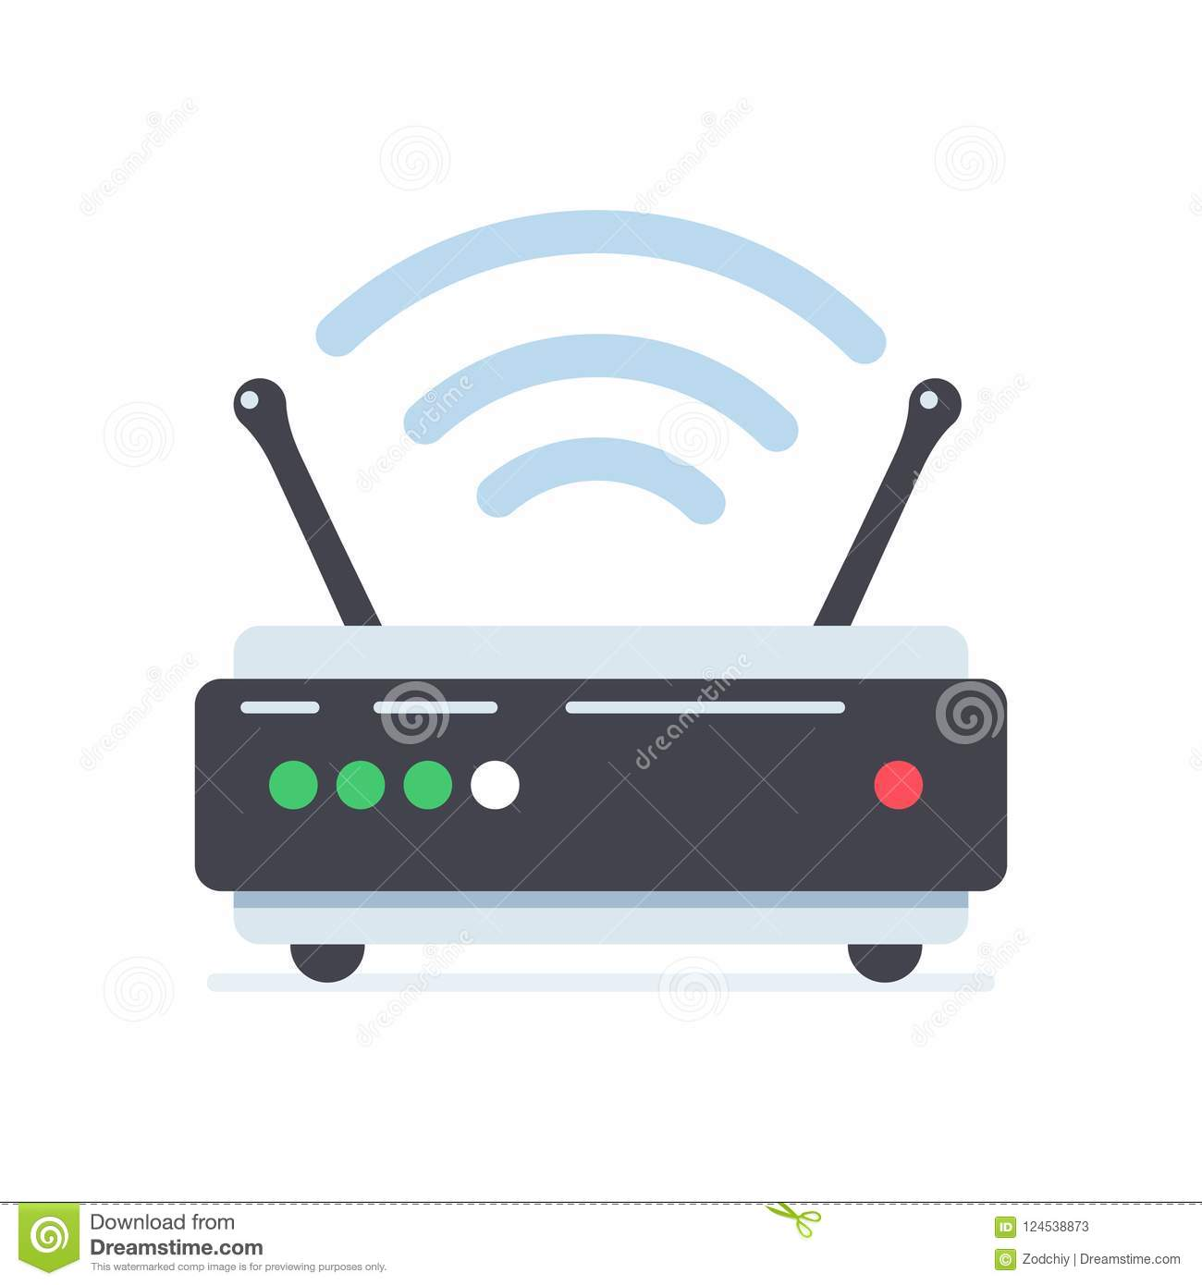
Antenna
Antenna Convert electrical impulses into electromagnetic waves

Slide 5
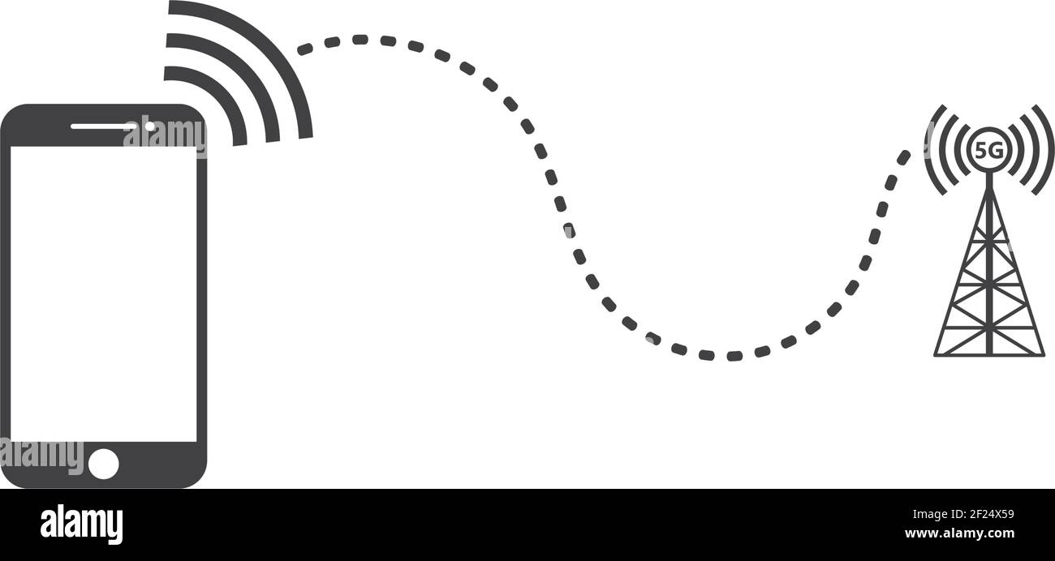

Slide 6
How does a the device locate the Tower ?
It doesn’t
Signal is transmitted in all direction
But for safety the message is encrypted
Only the respective tower has the key to decrypt the message

Slide 7
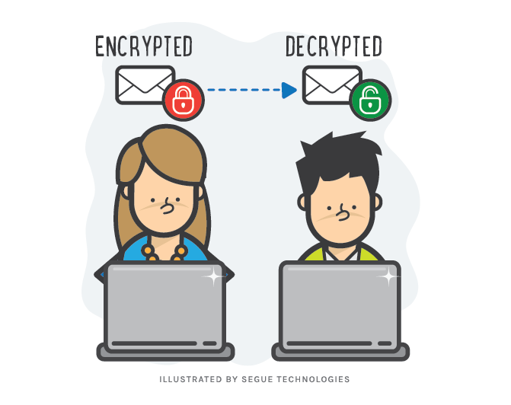

Slide 8
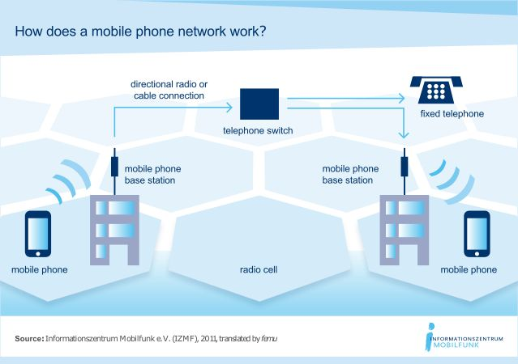

Slide 9
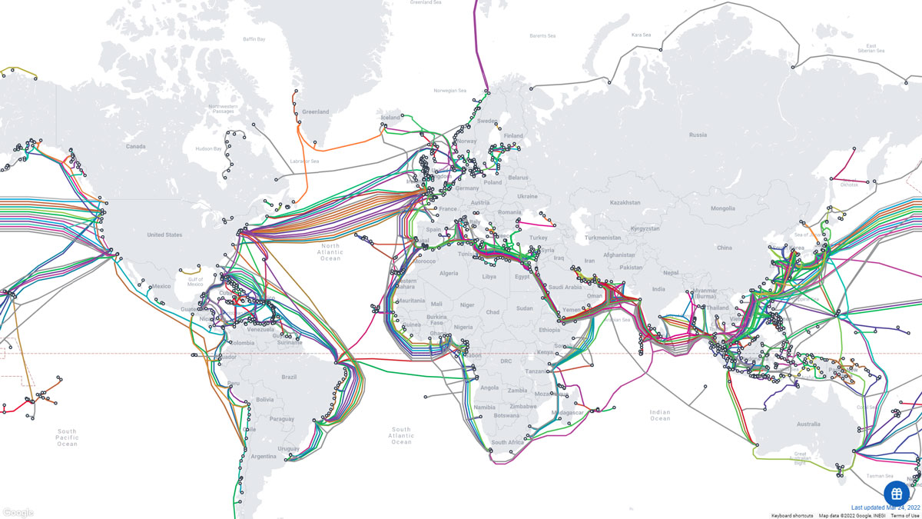

Slide 10
How are multiple messages differentiated ?
A set of communication protocols are defined
Different messages are sent over either
Different Frequencies
Different Locations
Separate time

Slide 11
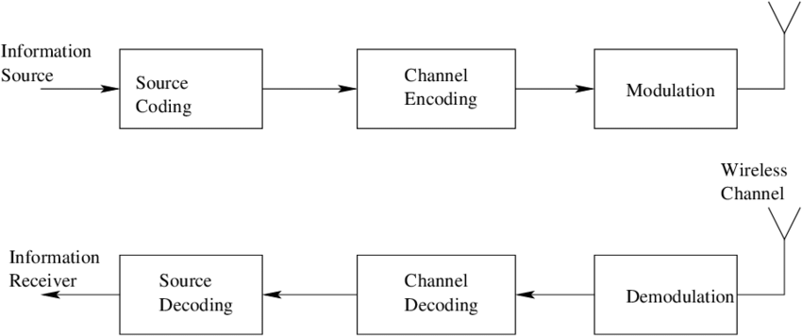
WIRELESS COMMUNICATION

Slide 12
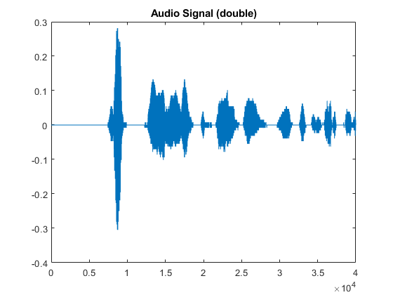
Source encoding aims to convert information waveforms (text, audio, image, video, etc.) in to a suitable form for applying signal processing techniques.
(Remove redundant information)

Slide 13
The channel encoder, does the coding for error correction. During the transmission of the signal, due to the noise in the channel, the signal may get altered and hence to avoid this, the channel encoder adds some redundancy.

Slide 14
Modulation is the process of converting data into radio waves by adding information to an electronic or optical carrier signal.
(process of encoding information from a message source in a way that is suitable for transmission)
MODULATION TECHNIQUE: ASK, PSK, FSK, etc.

Slide 15
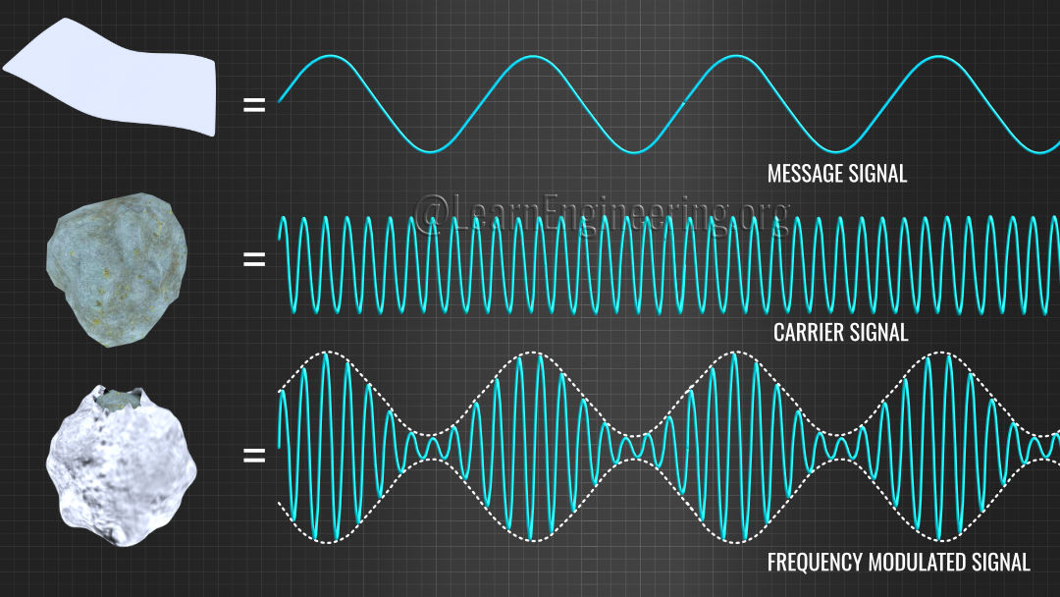

Slide 16
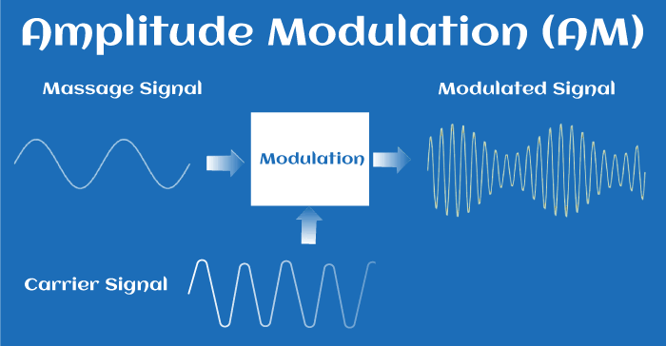

Slide 17
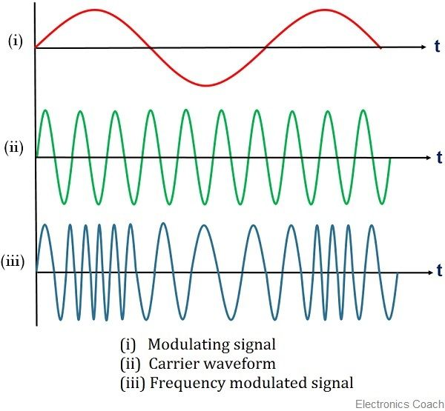

Slide 18
Why is Modulation Important ?
To reduce antenna size
To reduce interference

Slide 19
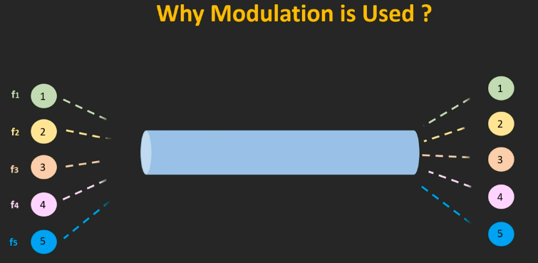

Slide 20
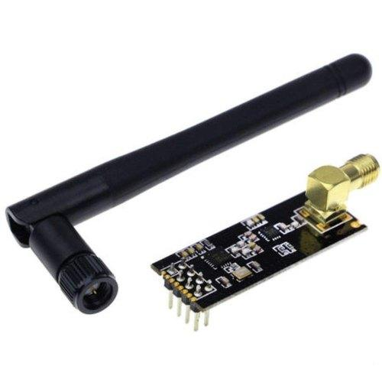
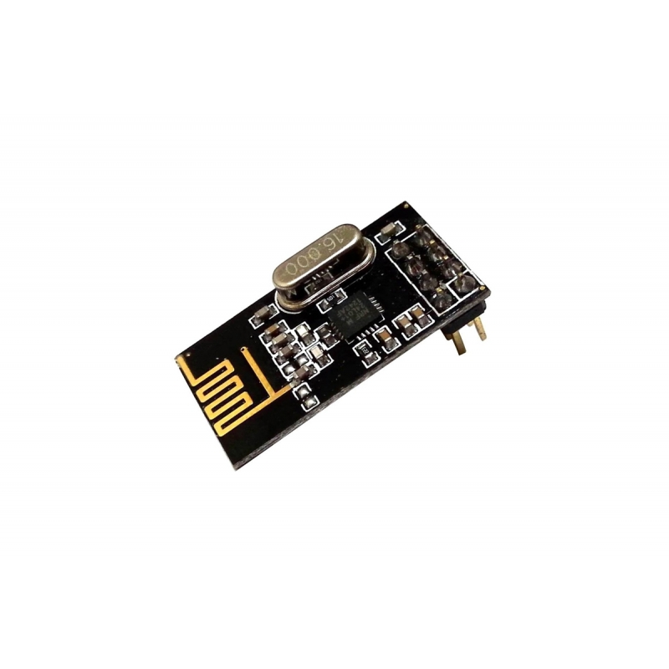
NRF24L01 MODULE

Slide 21
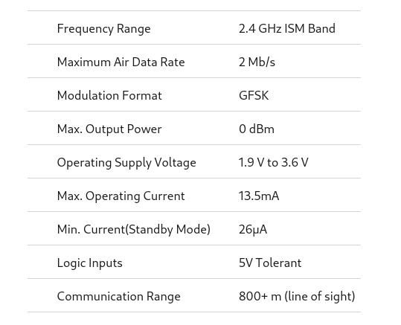

Slide 22
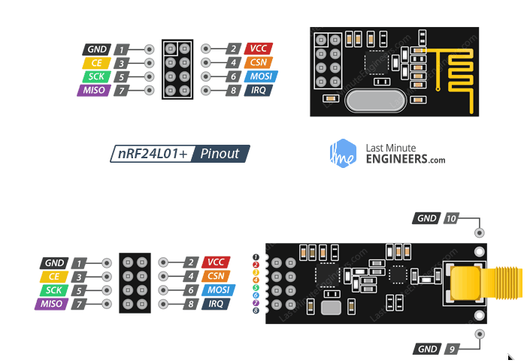

Slide 23
Communication Protocols
SPI Communication - Used by NRF24L01 module
I2C Communication
UART communication

Slide 24
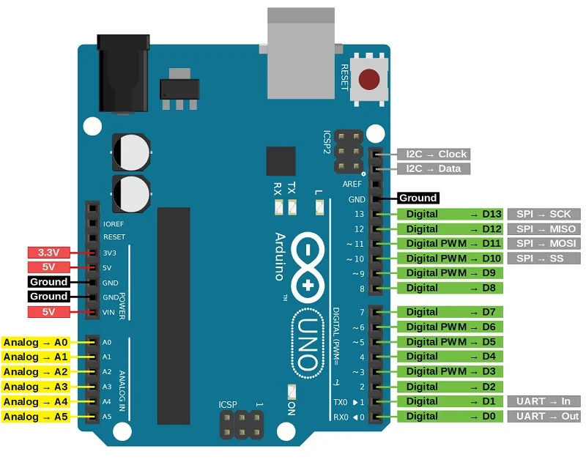

Slide 25
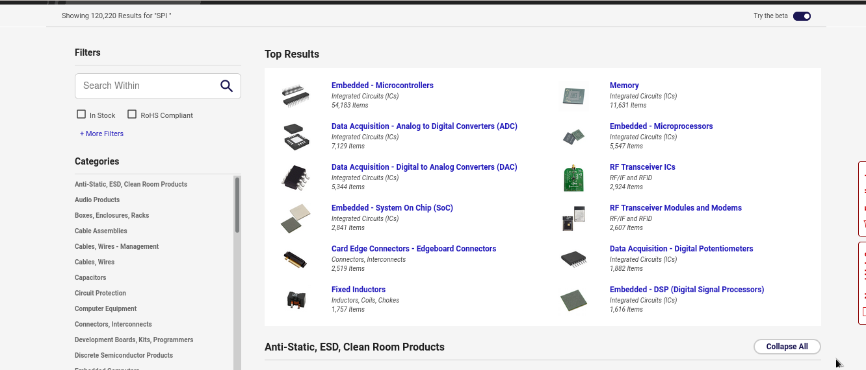

Slide 26
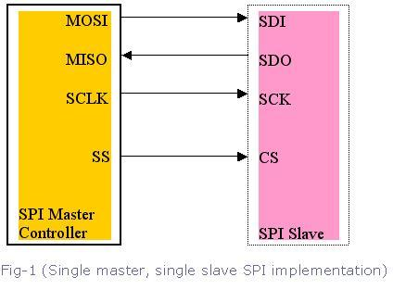
Serial Peripheral Interface (SPI) Communication

Slide 27
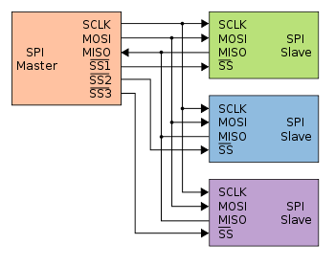
Serial Peripheral Interface (SPI) Communication

Slide 28
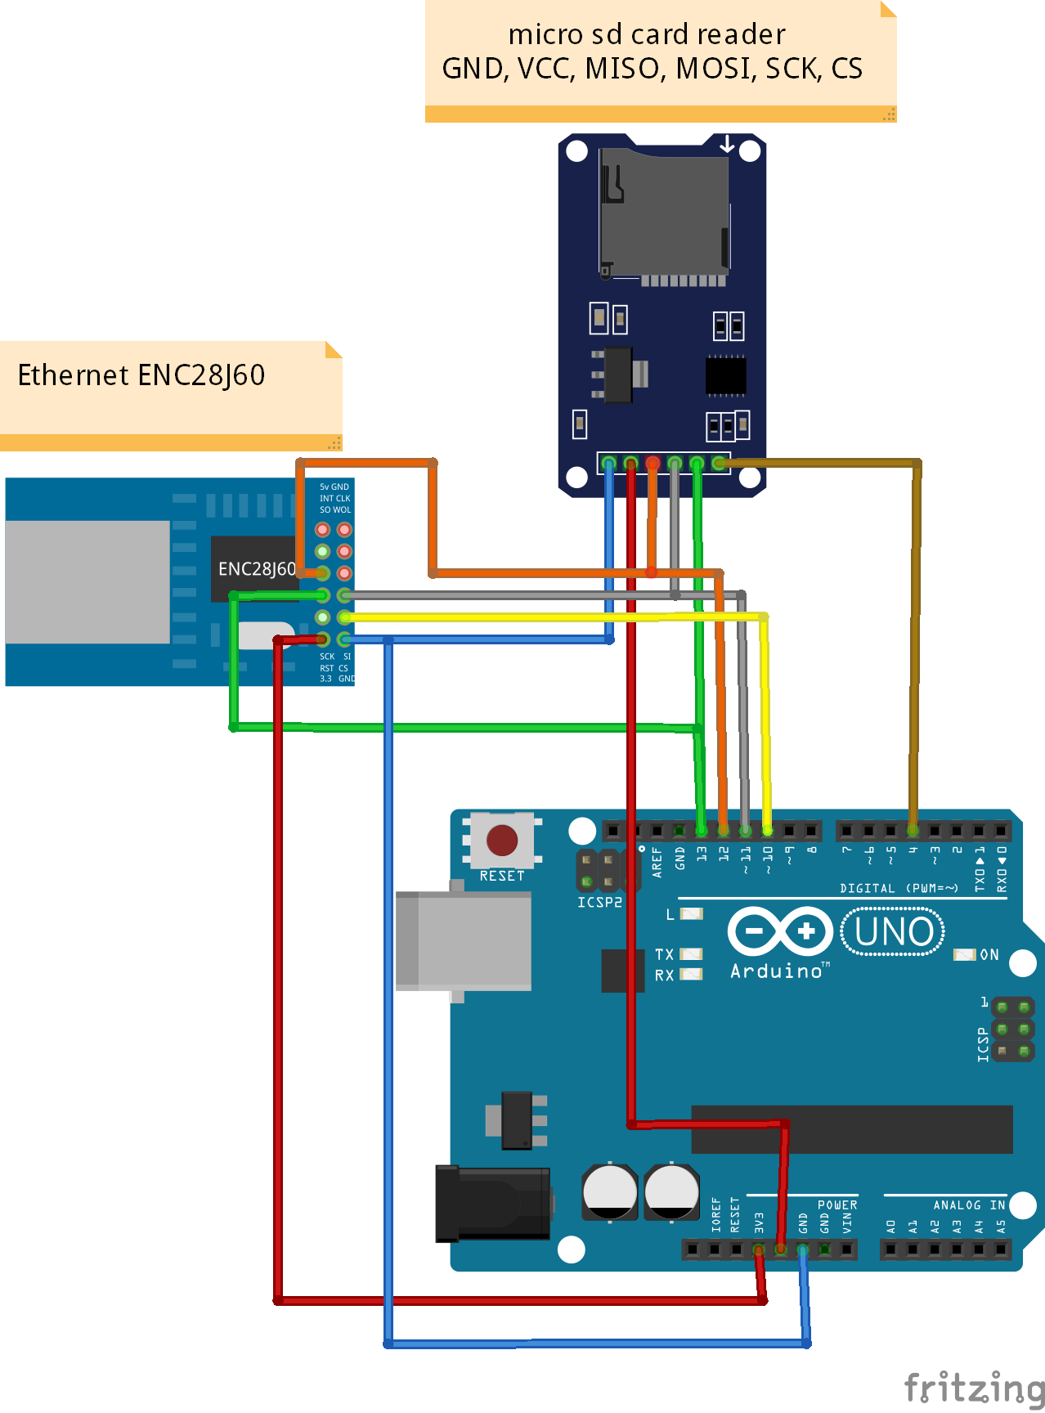

Slide 29
Why SPI
SPI is used for Gather data from sensor at high frequencies, With Display and serial flash to RAM.
Data Communication line is high input impedance until ss is ground.
Half and Full Duplex Communication.

Slide 30
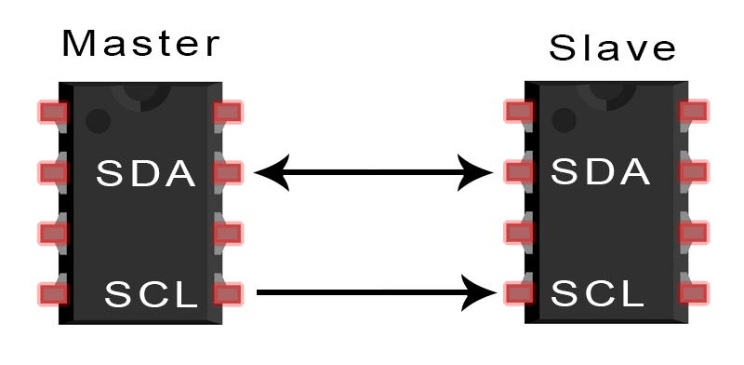
I2C Communication
To achieve serial data communication which are very close to each other
Multi-master capability
Communicates with slaves with slave address
Half duplex
Slave control over serial clock(clock stretching)
4 modes
Standard
Fast mode
Fast mode plus
High speed mode

Slide 31
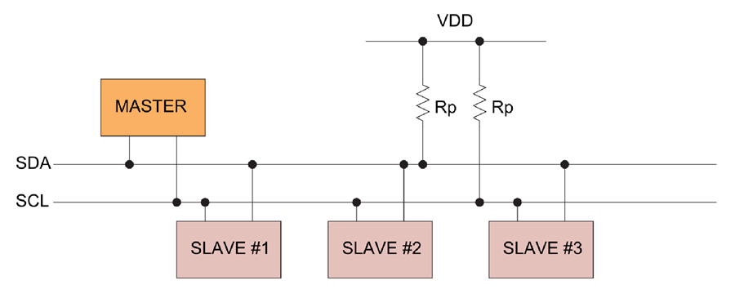

Slide 32
Logic State
Digital logic circuits have three logic states: high, low and floating(or high impedance)
The high-impedance state occurs when the pin is not pulled to a high or low logic level, but is left “floating" instead.
A good illustration of this is an unconnected input pin of a microcontroller.
It is neither in a high or low logic state, and the microcontroller might unpredictably interpret the input value as either a logical high or logical low.

Slide 33
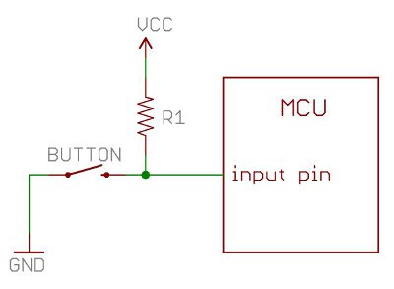
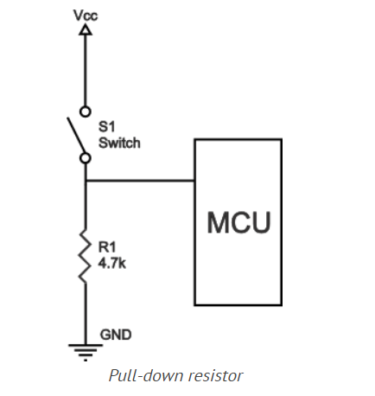
Pull up resistor

